Slide 1
Sentiment analysis on Fluoridated water in the USA using Twitter data

Slide 2
Summary Description (1/2)
Many research studies have proven the safety and benefits of fluoridated water. According to the CDC, Drinking fluoridated water helps prevent cavities by about 25 % in children and adults.
We want to know general feedback on water fluoridation on social media. It is hard to analyze many tweets manually; hence an automated way is essential
We also want to know the type of tweet a user tweets apart from the view about water fluoridation. Hence, I have included tweets related to Covid-19 vaccination
Extracted tweets containing keywords using snscrape library.
Total number of tweets containing keyword (from Jan to June 2020) – fluoride, fluorides, and fluoridation: 44.3K
Total number of tweets containing keyword (from Jun to Dec 2020) - Covid-19 vaccination: 6K
Reason for the date selection: since Covid 19 started spreading and would be interesting to know initial views about vaccination

Slide 3
Summary Description (2/2)
As per our requirement sentiment analysis is an appropriate method
Sentiment analysis is not an infamous technique in natural language processing that aims to find emotions/attitude towards a topic/sentence. It focuses on one of the three components – Polarity (positive, neutral, or negative), emotions (happy, sad, angry, etc.), and intentions (Interested or not interested). In this project, we will be analyzing public response (sentiment) for fluoridation of drinking water in the United States by performing sentiment analysis on tweets related to the topic.

Slide 4
I/O EXAMPLES
Input (Tweet) | Output (Polarity)
@PHARAOH_ATEN_ @YouTube Fluoride is a psychiatric drug! | -1 (Negative)
Drinking water with fluoride helps keep our teeth healthy by reducing cavities! Most tap water and filtered water has fluoride in it. If you drink bottled water, check to make sure it includes fluoride. Toothpaste with fluoride helps too! https://t.co/YDmDVJkSUV | 1 (Positive)
@StoppedAgo @Scacm When I gave birth 13 years ago.... and started researching vaccines, fluoride, Monsanto, etc. | 0 (Neutral)
Manually assigning sentiment to tweets is a tedious task, hence, an automated way is important.

Slide 5
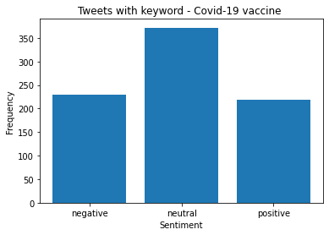
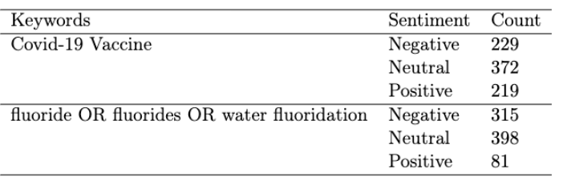
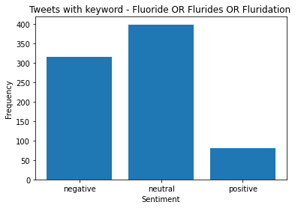
Data Distribution (1/2)
Distribution of manually annotated polarity in input data
Total Vaccine related tweets: 820
Total fluoride related tweets: 804
Total: 1624

Slide 6
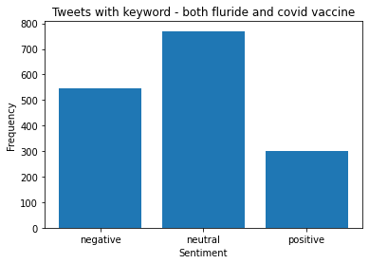
Data Distribution (2/2)
770
544
300

Slide 7
Pre-processing
Since we are working with the text data, there are several steps involved to clean the data:
URL/Emails/single quotes: Tweets contains URL, Emails, single quotes, they are not
important for the model hence, they have been removed.
Null value: Checked null tweets and replaced them with no content.
Label encoding: Converted the label (-1,0,1) into a machine-readable numeric form, used label encoding for the same. There are NAs in the label, which means the tweet is not very clear, since the future data will also consist of NAs those NAs have been considered as neutral.

Slide 8
Requirement and success assessment
Requirement
Definite requirement
The model will predict polarity with respect to water fluoridation.
It will also predict sentiment with respect to covid vaccination.
SUCCESS ASSESSEMENT
Success is measured by accuracy of classification of Train, validation, and Test dataset along with Recall, Precision, and F-Score.

Slide 9
Technology explained
Baseline method: GloVe: is an unsupervised learning algorithm for obtaining vector representations for words. Pre-trained model Training is performed on aggregated global word-word co-occurrence statistics from a corpus, and the resulting representations showcase interesting linear substructures of the word vector space.
Proposed method: (1) CNN: CNN can extract information but fails to persist the information, LSTM can address this limitation. (2) LSTM: Long Short-Term Memory Network is an advanced RNN, a sequential network, that allows information to persist. It can handle the vanishing gradient problem faced by RNN. A recurrent neural network also known as RNN is used for persistent memory
Explored method: (1) RNN: RNNs have a unique architecture that helps them to model
memory units (hidden state) that enable them to persist data, thus being able to model short term dependencies. BI-LSTM: In BI-LSTM (bidirectional), the input flows in two directions (both backward and forward), making a BI-LSTM different from the regular LSTM. Since the data flows backwards or forward it preserves the future and the past information

Slide 10
Training

Slide 11
Training
Dataset | Count
Train | 1461
Validation | 292
Test | 162
Combination of Hyperparameter explored
LSTM, BI-LSTM, and Simple RNN (units) | 64 | 70 | 700 | 786
Activation function | Relu | Tanh
Optimizer | Adam | Nadam | RMSprop
Learning rate | 0.01 | 0.001 | 0.0001 | Learning scheduler (exp decay)

Slide 12
Architectures Explored
Architecture | Accuracy (Train) | Accuracy (validation) | Accuracy (Test)
Simple RNN without GloVe embedding | 52% | 49% | 46%
Simple RNN with GloVe embedding | 40% | 38% | 39%
LSTM without GloVe embedding | 84% | 58% | 58%
LSTM with GloVe embedding | 69% | 52% | 54%
BI-LSTM without GloVe embedding | 97% | 53% | 55%
BI- LSTM with GloVe embedding | 73% | 52% | 61%
Conv1D without GloVe embedding | 87% | 50% | 54%
Conv1D with GloVe embedding | 90% | 54% | 55%
Note: Epoch for all the architecture = 5, activation function = Relu,
ResNet Unit network was also tested with and without GloVE, which did not give a reasonable accuracy on validation and test data.

Slide 13
Final model Architecture
Embedding
(input_dim = 6477, output_dim= 64, input_length = 100, embedding regularizer = L2 (0.001)
LSTM
(units = 64, activation="tanh", dropout=0.3, recurrent_dropout=0.2, return_sequences=True)
Conv1D
(filters = 64, kernel_size = 5, strides=1, padding="valid")
Flatten ()
Dense
( Units = 70, activation = Tanh)
Dense
( Units = 3, activation = Tanh)
Train accuracy = 84%
Test Accuracy = 60%
Epoch: 5
Learning rate: 0.001,
Optimizer: RMSprop
Note: Optimizer used: rmsprop,6477: word index

Slide 14
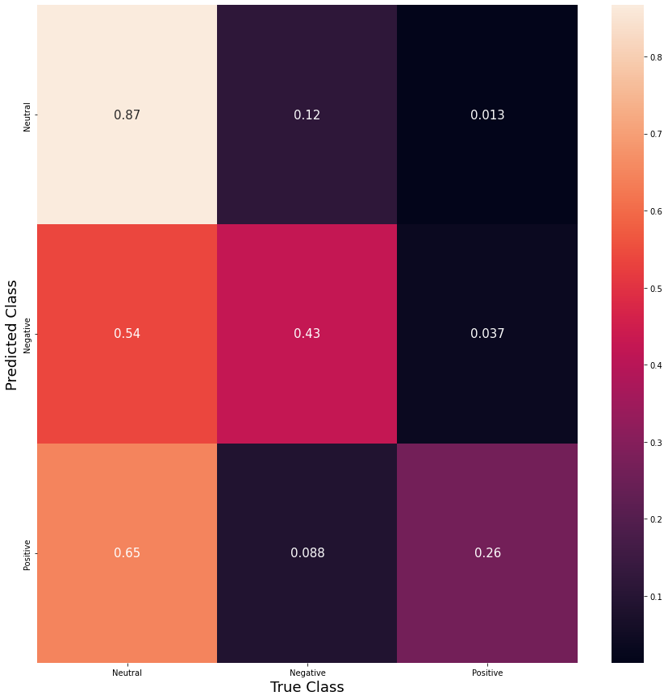
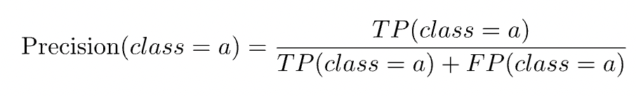

Model Assessment
 | Neutral | Negative | Positive | Average
F1_score | 0.68 | 0.51 | 0.39 | 0.56
Precision | 0.56 | 0.65 | 0.75 | 0.63
Recall | 0.86 | 0.43 | 0.27 | 0.60

Slide 15
Conclusion
In this project, we attempted to use sentiment analysis on twitter data to gauge user polarity (positive, negative, neutral) towards the topic of fluoridation in drinking water in the US
We experimented with simple RNN, LSTM, BI-LSTM, and Conv1D architectures to build the model.
We found that LSTM and Conv1D along with Dense layer performed better than single layer of LSTM/ Conv1D
Activation function Tanh and optimizer RMSprop gave the highest accuracy.
In future we can use the model to see the polarity distribution of users on the topics of fluoridated water and Covid-19. Also, we can analyze the user’s tendency of twitter posting.
We can also test the model on general population containing any keywords.

Slide 16
Thank You!

